Slide 1
Grupo 5
Etcheverri, Franco
Fullone, josefina
Luques, agustin
Martins forgan, diego

Slide 2

Seguridad en blockchain
+ Smart contracts

Slide 3
Agenda
Introducción de blockchain
Smart Contracts
Ethereum
Pilares de seguridad informática (Ethereum)
Ataques históricos
Ejemplos prácticos

Slide 4
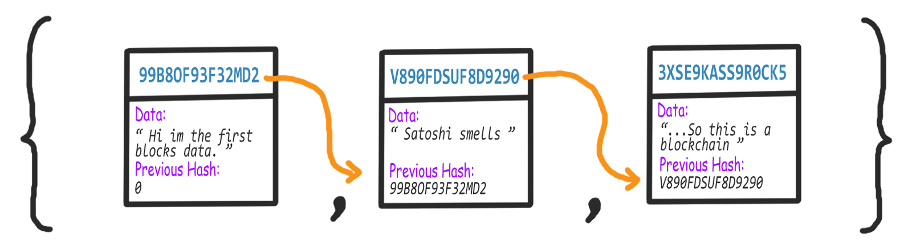
Esquema
Notes:
A blockchain is just a chain/list of blocks. Each block in the blockchain will have its own digital signature (hash), contain digital signature of the previous block, and have some data (this data could be transactions for example).
Each block is connected to all the blocks before and after it. This makes it difficult to tamper with a single record because a hacker would need to change the block containing that record as well as those linked to it to avoid detection.
The records on a blockchain are secured through cryptography. Network participants have their own private keys that are assigned to the transactions they make and act as a personal digital signature. If a record is altered, the signature will become invalid and the peer network will know right away that something has happened.

Slide 5

Notes:
Unfortunately for those ambitious hackers, blockchains are decentralized and distributed across peer-to-peer networks that are continually updated and kept in sync. Because they aren’t contained in a central location, blockchains don’t have a single point of failure and cannot be changed from a single computer. It would require massive amounts of computing power to access every instance (or at least a 51 percent majority) of a certain blockchain and alter them all at the same time. There has been some debate about whether this means smaller blockchain networks could be vulnerable to attack, but a verdict hasn’t been reached. In any case, the bigger your network is, the more tamper-resistant your blockchain will be.

Slide 6
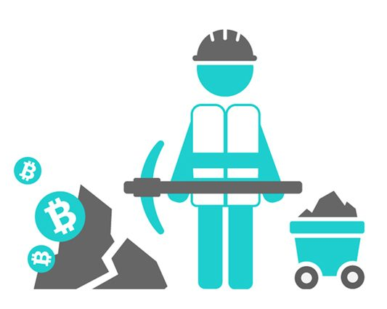
Nuevos bloques
”Proof of work”
Los participantes de la red deben llegar a un consenso para agregar una transacción nueva a la blockchain
Notes:
For a transaction to be added to a blockchain, network participants must agree that it is the one and only version of the truth. That is done through consensus, which means agreement. Bitcoin is probably the most well-known example of a public blockchain and it achieves consensus through “mining.” In Bitcoin mining, computers on the network (or ‘miners’) try to solve a complex cryptographic problem to create a proof of work. The drawback is that this requires an enormous amount of computational power, especially for large-scale public blockchains.
The assumption that one can’t trust anyone’s reports leads to the conclusion that one has to be able to confirm things for oneself. This gives rise to the notion that when presented with a transaction, the recipient must ensure by personally reviewing the entire history of transactions the fact that the sender is in fact in possession of the funds and that the way this came to be is valid. This, in turn, leads us down the path of shared ledgers where the main premise is that the entire history of all transactions is completely open and public. Producing multiple self-consistent ledgers is still not very hard. For example, you can easily create a ledger that only differs in the last transaction in the account from which you hold the cryptographic key. In the crypto parlance this is referred to as the double-spend problem. It is so called because of the possibility that someone malicious can present two different ledger states to two different users, or even worse — present the entire network with a ledger state and then present the entire network with a different state but one that will be ultimately accepted, negating the first one. We point out that the choice between conflicting states is not one where one state is a-priori good and another is a-priori bad, since we posited that both states are totally self-consistent. The difference between a good state and a bad state is that of consensus only, that is if we can all agree on which one is good and simply ignore the other one, we will have solved the problem. So what we want is a situation where once we see a state of a ledger and accept it as good, that we must all believe that it will be impossible to create a better one later. And this is where proof of work comes in. Proof of work adds artificial computational difficulty to the ledger. The common protocol requires that of any two conflicting states we observe on the network we select the one that was hardest to generate. We also require that there is a common and high level of hardness to recording transactions in the ledger.
Mining is a process of generating proof of work. The way it works is that all miners compete to find a number that, when added to the block of transactions, causes this block to hash to a code with certain rare properties. Based on the cryptographic features of the hash function used in this process, finding such a rare number is hard, but verifying its validity when it is found is easy. For the ledger to be considered self-consistent we require that every block contain such rare number whose hardness we control based on the size of the participating network (a value expressed as a hash-rate). This ensures that once we observe a valid state of the ledger, transactions that have certain age can not be negated, because producing a longer ledger than the one we see requires the malicious entity to have computing power that can compete with the entire existing network. Consequently, these transactions have lasting consensus regarding their validity.

Slide 7

Smart contracts

Slide 8
1.
¿Qué son?

Slide 9


Slide 10
“programa informático que ejecuta acuerdos establecidos entre dos o más partes haciendo que ciertas acciones sucedan como resultado de que se cumplan una serie de condiciones específicas”
Notes:
Because smart contracts run on the blockchain, they run exactly as programmed without any possibility of censorship, downtime, fraud or third party interference.

Slide 11
2.
¿cómo funcionan?

Slide 12

Ethereum

Slide 13
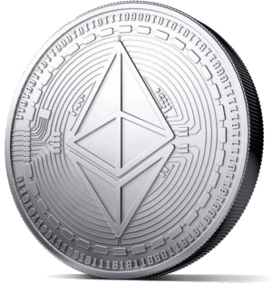
Ethereum
Plataforma pública basada en blockchain más utilizada para generar y ejecutar Smart Contracts
“Ether”: token utilizado como medio de pago por el procesamiento computacional necesario
Notes:
While the Bitcoin blockchain is used to track ownership of digital currency (bitcoins), the Ethereum blockchain focuses on running the programming code of any decentralized application.

Slide 14
Proceso de Ethereum
Hacer un deploy del contrato
Llamar a los métodos del contrato
Escribir el código del contrato
Notes:
On Ethereum, you write code by publishing contracts (which you can think of as objects), and transactions are executed by calling methods on these objects to mutate their state.
In order to run code on Ethereum, you need to first deploy the contract (the deployment is itself a transaction), which costs a small amount of Ether. You then need to call methods on the contract to interact with it, which costs more Ether.

Slide 15
3.
Pilares de seguridad

Slide 16

+ no repudio
Autenticación
Digital Signature: forma de probar que alguien es quien realmente dice ser mediante la utilización de funciones matemáticas y criptográficas
Notes:
Digital signatures, like real signatures, are a way to prove that somebody is who they say they are, except that we use cryptography or math, which is more secure than handwritten signatures that can be easily forged. A digital signature is a way to prove that a message originates from a specific person and no one else, like a hacker. Every transaction that is executed on the blockchain is digitally signed by the sender using their private key. It provide a way to ensure that all transactions are only made by the rightful owners.

Slide 17
Elliptic Curve Digital Signature Algorithm (ECDSA)
Implementación más eficiente que la mayoría de los algoritmos similares (Ej: RSA)
Tamaño de clave relativamente chico
El “SEC Group’s curve secp256k1” usado en Ethereum es matemáticamente seguro
Notes:
In Ethereum like any other blockchain system there is a private and a public key. These keys are generated when you create a new blockchain “account”. Elliptic Curve Cryptography (ECC) and ECDSA are a specific flavor of asymmetric cryptography. They are widely used in blockchain technology because of three reasons:
Their computational performance is economical compared to a lot of other algorithms
The keys that are generated are relatively short
Bitcoin started it, so most new blockchain projects have copied it

Slide 18
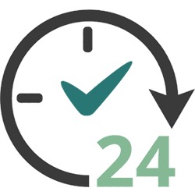
Disponibilidad
La gran descentralización de la red brinda una disponibilidad teórica del 100%
Al momento existen 17 mil nodos ejecutando la blockchain Ethereum en 6 continentes.
Notes:
The general architecture of blockchains is well suited for high availability scenarios, because they are designed to avoid single points of failure.
And because the Ethereum network is decentralized, you'll be able to provide services with a 100% uptime guarantee.

Slide 19
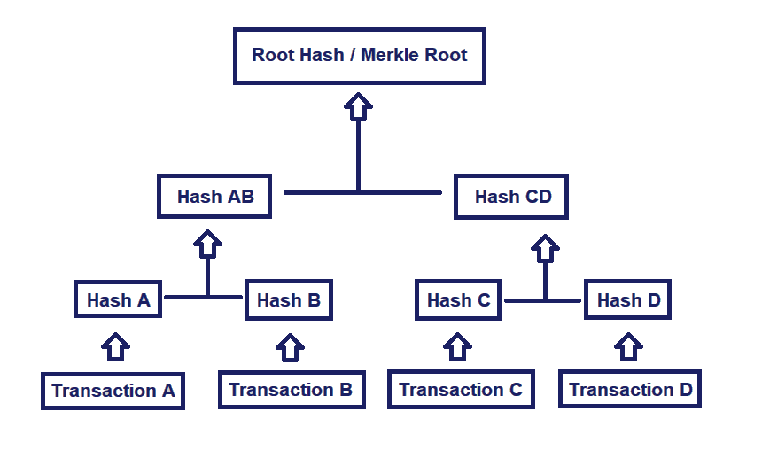
Integridad
Notes:
Merkle trees are a fundamental part of blockchain technology. A merkle tree is a structure that allows for efficient and secure verification of content in a large body of data. This structure helps verify the consistency and content of the data. Merkle trees are used by both Bitcoin and Ethereum. A Merkle tree summarizes all the transactions in a block by producing a digital fingerprint of the entire set of transactions, thereby enabling a user to verify whether or not a transaction is included in a block.
Merkle trees are created by repeatedly hashing pairs of nodes until there is only one hash left (this hash is called the Root Hash, or the Merkle Root). They are constructed from the bottom up, from hashes of individual transactions (known as Transaction IDs).
Each leaf node is a hash of transactional data, and each non-leaf node is a hash of its previous hashes. Merkle trees are binary and therefore require an even number of leaf nodes. If the number of transactions is odd, the last hash will be duplicated once to create an even number of leaf nodes.
The Merkle Root summarizes all of the data in the related transactions, and is stored in the block header. It maintains the integrity of the data. If a single detail in any of the transactions or the order of the transactions changes, so does the Merkle Root.
Ethereum uses a special type of hash tree called the ‘Merkle Patricia Tree’. The simplest explanation for how it works is that the key under which a value is stored is encoded into the "path" that you have to take down the tree. Each node has 16 children, so the path is determined by hex encoding: for example, the key dog hex encoded is 6 4 6 15 6 7, so you would start with the root, go down the 6th child, then the fourth, and so forth until you reach the end.
Merkle Proof to quickly validate if a transaction is in a particular block (Allows light clientes - Not need to hold all)

Slide 20
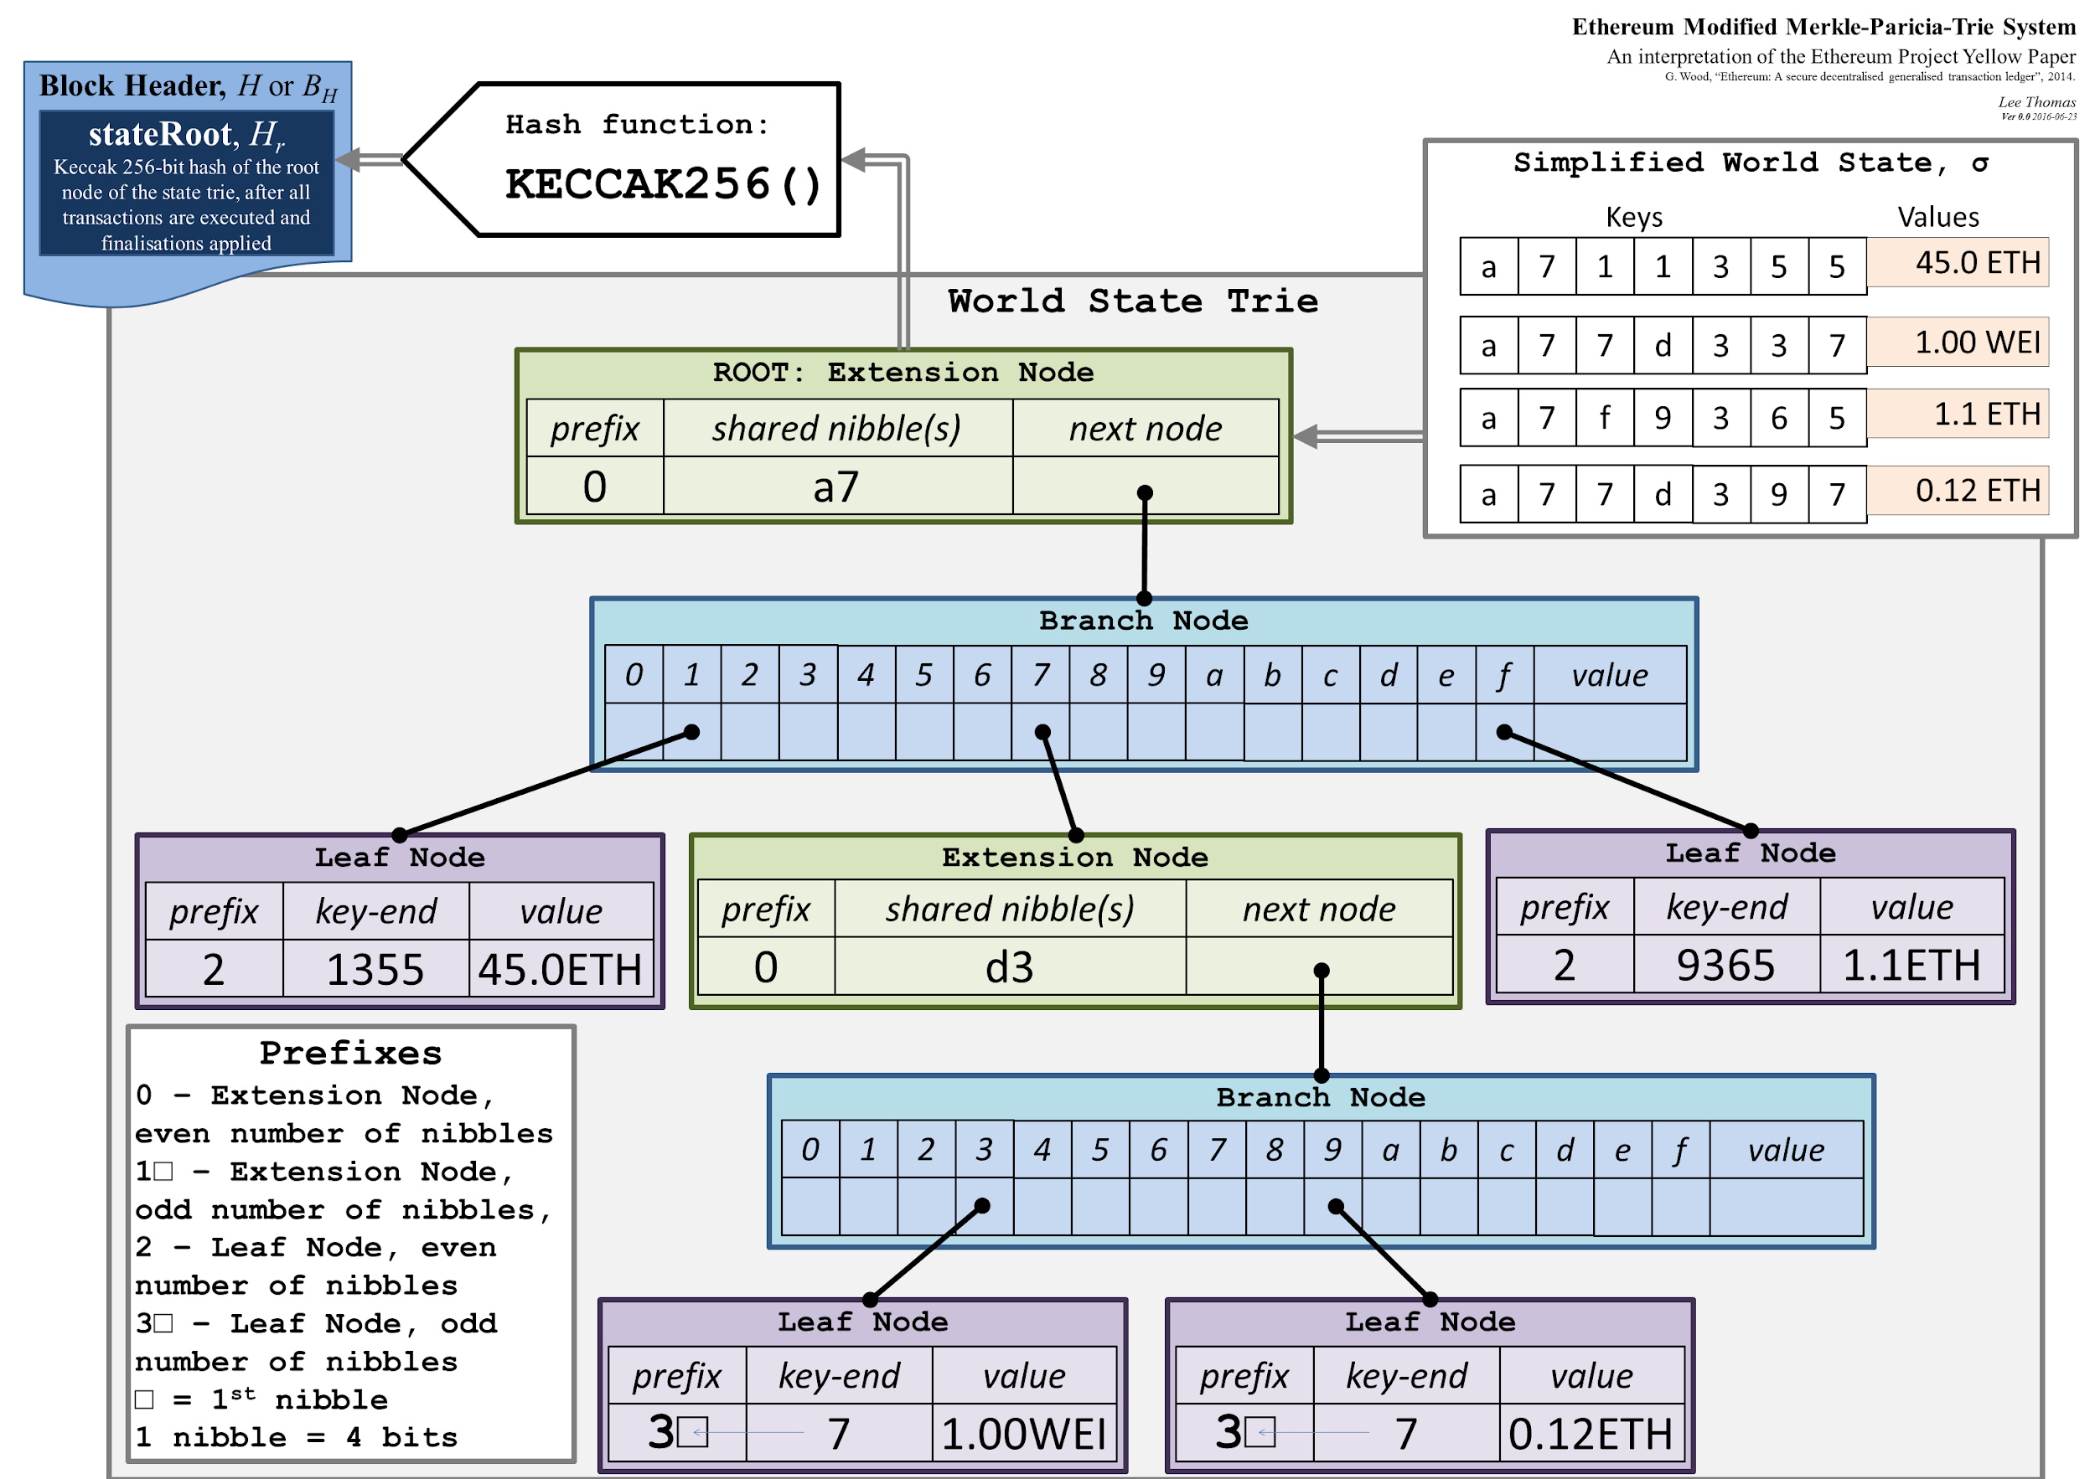

Slide 21

↑ privacidad?
¿Anonimato?
Pseudo-anonimato: cualquiera puede crear una “blockchain address”, pero a partir de ella no hay forma de saber a qué persona física corresponde
Notes:
Public blockchains use computers connected to the public internet to validate transactions and bundle them into blocks to add to the ledger. Any computer connected to the internet can join the party. They are typically designed around the principle of anonymity. However, a contradicting statement arises from here, if blockchain is complexly anonymous then how it is verifiable. For example, we consider Bitcoin pseudo-anonymous. By pseudo-anonymity, we mean that a person will be linked to a public Bitcoin address, but no one will get to know the actual person. To explain this in simple words, suppose a person sends a sum of money, then the receiver will get to know that the sender is linked to a bitcoin address but will not know the actual address. Decentralization and anonymity is the key for any cryptocurrency transaction; however, with its rising pace, we also witness some points of concern like how far it is good to continue to do the transaction without government control, lack of regulatory authority and maintaining pseudo-anonymity.

Slide 22

Confidencialidad
Es posible llevar un seguimiento de todas las transacciones de la red
El código de los contratos deployados es accesible por cualquier persona mediante Etherscan
Las transacciones en Ethereum no están encriptadas
Notes:
Smart Contract transactions are not confidential. Everyone can access and see all information that is sent to and stored in a smart contract.
Ethereum transactions are not encrypted, so no decryption is necessary. Logging all transactions to disk is part of being a node (miner or any full node), so no tweaking is necessary. You can see every historic transaction in the clear at sites like Etherscan. So, as it stands, there is no transaction confidentiality on the public Ethereum blockchain.This may change in future if/when ZK Snark technology gets implemented. Variants of Ethereum exist (such as Quorum) with mechanisms for private transactions, but these don't transfer over to the public Ethereum blockchain.

Slide 23

Ejemplo práctico

Slide 24
4.
¿son invulnerables?

Slide 25
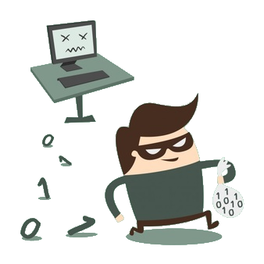
Parity wallet attack
19/07/2017
Notes:
Around 12:00 PST, an unknown attacker exploited a critical flaw in the Parity multi-signature wallet on the Ethereum network

Slide 26

$31,000,000
en Ether
Notes:
...draining three massive wallets of over $31,000,000 worth of Ether in a matter of minutes. Given a couple more hours, the hacker could’ve made off with over $180,000,000 from vulnerable wallets.

Slide 27

Ethical Hacking
Traditional Hacking
VS
Notes:
Having sounded the alarm bells, a group of benevolent white-hat hackers from the Ethereum community rapidly organized. They analyzed the attack and realized that there was no way to reverse the thefts, yet many more wallets were vulnerable. Time was of the essence, so they saw only one available option: hack the remaining wallets before the attacker did.
To prevent the hacker from robbing any more banks, the white-hats wrote software to rob all of the remaining banks in the world. Once the money was safely stolen, they began the process of returning the funds to their respective account holders.

Slide 28

Wallets
Multi-signature Wallets
Forma en la que se almacenan los bienes
El acceso está restringido mediante una clave privada
Wallet en la que existen múltiples claves privadas
Se determina la cantidad de claves necesarias para el desbloqueo
Notes:
La dirección es una clave privada que es generada por la propia plataforma Bitcoin. Se trata de un identificador de una longitud considerable y sin ningún tipo de orden (difícil de memorizar y muy segura, al contrario de lo que comentábamos antes de las contraseñas del correo electrónico) que no debes de compartir con nadie, ya que con esa cadena de caracteres tienes acceso directo al saldo en Bitcoins.
Para poder usar esa cuenta en Bitcoin, la criptografía viene en nuestra ayuda: a cada dirección privada le corresponde una dirección pública que puedes compartir para que te puedan transferir fondos (del mismo modo que con tu dirección email te podrían enviar correos). Esta dirección pública vuelve a ser una cadena de caracteres difícil de memorizar (normalmente se maneja a través de un código QR), pero que no permite más que hacer transacciones de abono de moneda digital y de consulta (los datos de la Blockchain recordemos que son públicos).
This means that if you, your father, and your mother are each signatories on this wallet, even if a criminal hacked your mother and stole her private key, they could still not access your funds. This leads to much stronger security guarantees, so multi-sigs are a standard in wallet security.

Slide 29
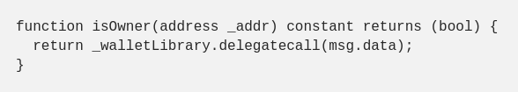
external
library
Llamada a la librería externa
Notes:
One way to reduce costs is to use libraries. By making your contract call out to a shared library that was deployed at a previous time, you don’t have to re-deploy any shared code.
The default multi-sig wallet in Parity did exactly this. It held a reference to a shared external library which contained wallet initialization logic. This shared library is referenced by the public key of the library contract.
Here’s an example of this in their multi-sig wallet: the isOwner method just delegates to the shared wallet library's isOwner method, using the current contract's state:

Slide 30
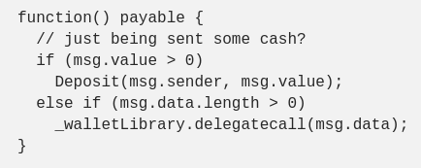
Fallback method
Método que es llamado cuando no existe ningún método que coincida con el nombre de método dado
Parity Team
Notes:
It’s important to understand that this exploit was not a vulnerability in Ethereum or in Parity itself. Rather, it was a vulnerability in the default smart contract code that the Parity client gives the user for deploying multi-signature wallets.
The exploit was almost laughably simple: they found a programmer-introduced bug in the code that let them re-initialize the wallet, almost like restoring it to factory settings. Once they did that, they were free to set themselves as the new owners, and then walk out with everything.
Solidity allows you to define a “fallback method.” This is the method that gets called when there’s no method that matches a given method name. You define it by not giving it a name. The Parity team decided to let any unknown method that sent Ether to the contract just default to depositing the sent Ether.
(// payable is just a keyword that means this method can receive/pay Ether)
Basically:
If the method name is not defined on this contract
And there’s no ether being sent in the transaction
And there is some data in the message payload
Then it will call the exact same method if it’s defined in _walletLibrary, but in the context of this contract.

Slide 31
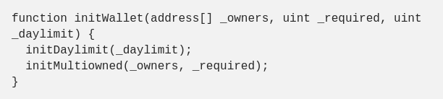
“El ataque”
Notes:
Using this, the attacker called a method called initWallet(), which was not defined on the multisig contract but was defined in the shared wallet library. Which calls the initMultiowned method...

Slide 32
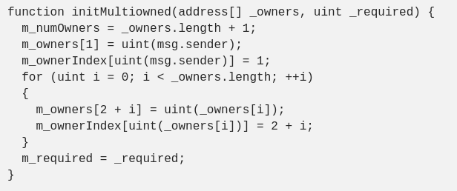
“El ataque”
Notes:
The attacker essentially reinitialized the contract by delegating through the library method, overwriting the owners on the original contract. They and whatever array of owners they supply as arguments will be the new owners.Given that they now control the entire wallet, they can trivially extract the remainder of the balance. And that’s precisely what they did.

Slide 33
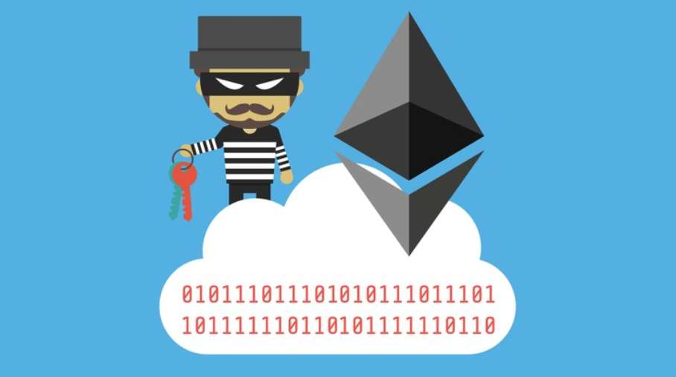
The DAO hack
Reentrancy
Junio 2016

Slide 34
In simple words, it's like the bank teller doesn't change your balance until she has given you all the money you requested.
“Can i withdraw $500? Wait, before that, can i withdraw $500?”
An so on. The smart contract as designed only check you have $500 at the beginning, once, and allow themselves to be interrupted.

Slide 35


Slide 36
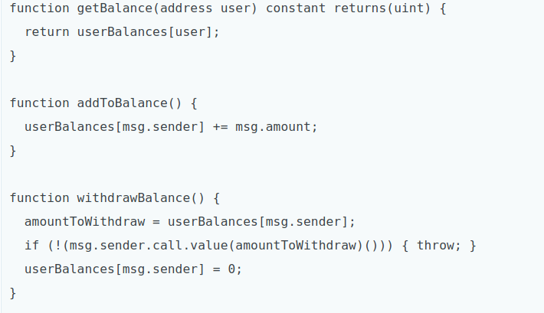
Al principio todo parece normal

Slide 37
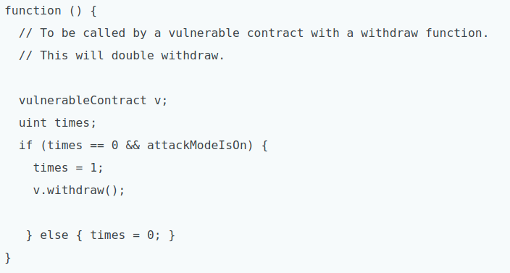
Pero no siempre es así. . .

Slide 38
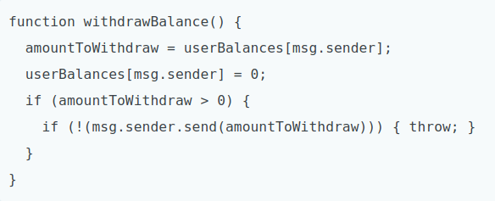
Una solución

Slide 39
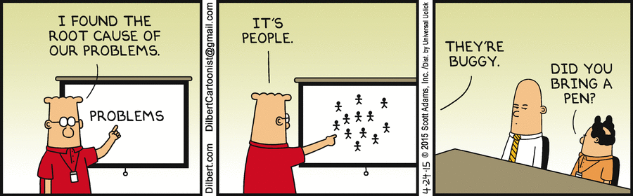

Slide 40

Ejemplos prácticos

Slide 41
Conclusiones
Las vulnerabilidades propias de los smart contracts se basan netamente en errores de codificación o bugs en “solidity”.
Por el motivo antes mencionado, deben testearse MUCHO los contratos antes de hacer el deploy.
Una vez que se hace deploy de un contrato, éste NO puede ser modificado.
Los smart contract eliminan la necesidad de un tercero para resolver el manejo de fondos o de disputas.
Notes:
Contracts deployed on a blockchain are immutable. This means that the address and the code of that Smart Contract can’t be modified since it’s permanently written on the blockchain. However there are ways to use a new contract instead of that one, which is similar to “updating” a contract. One way to update the code is to create an intermediary Smart Contract that will hold the address of the active Smart Contract. So all the calls and transactions will be redirected to the active version with the function delegatecall. That way, you’ll be using the same contract address but that contract will execute a different Smart Contract code in the end. From an “updated” contract. Another way is to simply extract all the information from the old contract and insert it into a new version. Then update the address that your users will see.
EJEMPLO KICKSTARTER APUESTAS

Slide 42

Muchas gracias!
¿Preguntas?

